Slide 1

AGRO
SMART
Ezaz Alam Ahmed

Slide 2

THE OBJECTIVE
The main objective of this prototype is to simplify integrating technology into farming, especially urban farming.

Slide 3
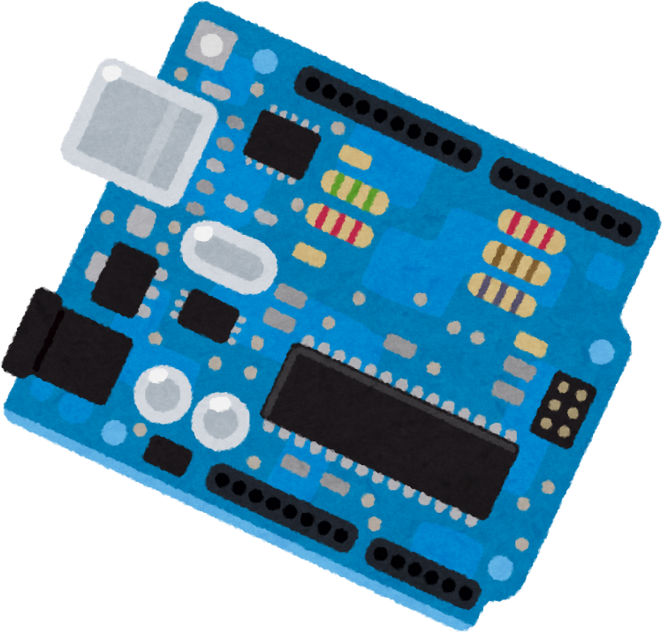
HARDWARE
HOW
IT
WORKS?
IT COLLECTS THE DATA OF TEMPERATURE, HUMIDITY AND MOISTURE LEVEL IN SOIL THEN SENDS TO THE MOBIE APP OVER WIFI. IT ALSO AUTOMATES THE WATER FLOW
SOFTWARE
ON THE SOFTWARE SIDE IT HAS THE APP, IN ONE PART IT DISPLAYS ALL THE DATA RECEIVED FROM THE MODEL, ON THE OTHER, IT INTERACTS WITH THE AI WHICH HELPS THE USER.

Slide 4
VERSIONS
V 1.0
V 1.2
V 2.0
Initial version
Hard to use
Slow mobile app
Limited AI functionality
Second version
Easier to use
Slow mobile app
Limited + Slower AI functionality
Third version
Easier to use
Faster mobile app
Faster + Enhanced AI functionality (Free chat)

Slide 5

THANK
YOU

